Slide 1
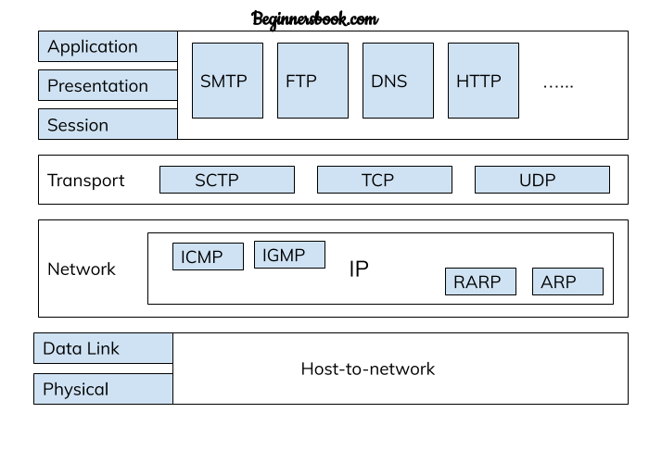

Slide 2
Address Resolution Protocol (ARP)

Slide 3
What is ARP?
The knowledge of hosts’ IP address is not sufficient for sending packets, because data link hardware does not understand internet addresses.
In an Ethernet network, the Ethernet controller card can send and receive using 48-bit Ethernet (MAC) addresses and the 32-bit IP addresses are unknown to these cards.
This requires a mapping of the IP addresses to the corresponding Ethernet addresses which is accomplished by Address Resolution Protocol (ARP).

Slide 4
Working of ARP: First Approach
One possible approach is to have a configuration file somewhere in the system that maps IP addresses onto the Ethernet addresses.
Although this approach is straightforward, maintaining an up-to-date table has a high overhead on the system.

Slide 5
Working of ARP: Second Approach (Widely used)
Second approach is to broadcast packet onto the Ethernet asking “who owns the destination IP address?”.
Destination node responds with its Ethernet address after hearing the request.
ARP is a dynamic mapping approach for finding a physical address for a known IP address.
It involves following two basic
An ARP request is broadcast to all stations in the network
An ARP reply is an unicast to the host requesting the mapping
To improve the efficiency of the ARP protocol, cache memory is used to hold the recently acquired frame containing the physical address.
As a consequence, no broadcasting is necessary in near future.

Slide 6
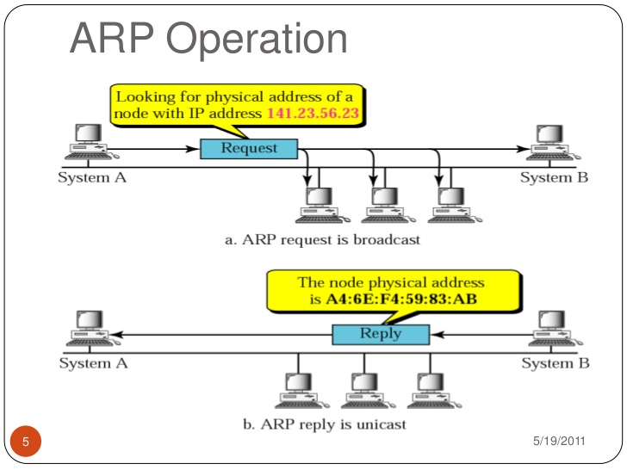

Slide 7
Reverse ARP (RARP)
Used by a computer to find out its own IP address.
It involves the following steps:
Host A broadcasts a RARP request specifying itself as the target
RARP server responds with the reply directly to host A
Host A preserves the IP address in its main memory for future use until it reboots

Slide 8
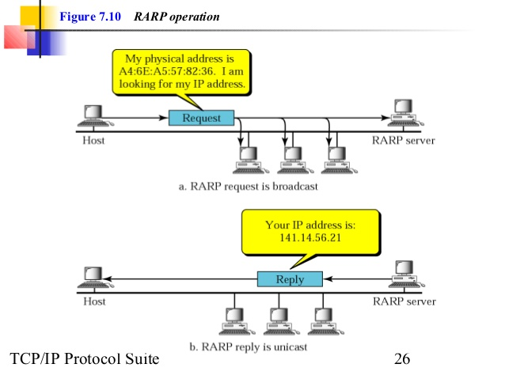

Slide 9
ICMP: Purpose
To make efficient use of the network resources, IP was designed to provide unreliable and connectionless best-effort datagram delivery service.
As a consequence, IP has no error-control mechanism and also lacks mechanism for host and management queries.
A companion protocol, which operates in the Network Layer too, known as Internet Control Message Protocol (ICMP), has been designed to compensate these two deficiencies.

Slide 10
ICMP
ICMP messages can be broadly divided into two broad categories:
Error reporting Messages:
Destination unreachable,
Time exceeded,
Source quench,
Parameter problems,
Redirect
Query:
Echo request and reply,
Timestamp request and reply,
Address mask request and reply

Slide 11
QoS Parameters
Throughput:
No. of packets that arrive at their destinations successfully per unit time,
Delay or Packet End-to-End Delay or Latency:
Time taken by a packet to travel from the source to the destination.
Jitter:
Variation in the latency on a packet flow between two systems, when some packets take longer to travel from one system to the other.
Uniform Latency=> 0 jitter.
Non-uniform: +ve or –ve jitter.
Bit Error Rate

Slide 12
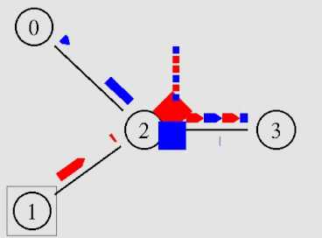
What is Congestion?
Internet can be considered as a Queue of packets, where transmitting nodes are constantly adding packets and some of them (receiving nodes) are removing packets from the queue.
Too many packets are present in this queue (or internet or a part of internet), when constantly transmitting nodes are pouring packets at a higher rate than receiving nodes are removing them.
This degrades the performance, and such a situation is termed as Congestion.

Slide 13
Congestion Control
Objective: maintain the number of packets in the network below the level at which performance falls off dramatically.
Nature of a Packet switching network:
A network of queues
At each node, there is a queue of packets for each outgoing channel
If packet arrival rate exceeds the packet transmission rate, the queue size grows without bound
When the line for which packets are queuing becomes more than 80% utilized, the queue length grows alarmingly

Slide 14
Congestion
If number of packets sent is within the carrying capacity, they all delivered
If traffic increases too far, the routers are no longer able to cope, and they begin to lose packets - Congestion.
At very high traffic, performance collapse completely, and almost no packet is delivered.

Slide 15
Causes Of Congestion
Memory:
Stream of packets arrive suddenly on several input lines and need to be out on the same output line, forming a long queue
Insufficient memory in the routers, lead to packet drop.
Even infinite amount of memory will increase congestion; because by the time packets gets at the head of the queue, they will time-out (repeatedly), and duplicates may also be present.
All the packets will be forwarded to next router up to the destination, all the way only increasing the load to the network more and more.
Finally when it arrives at the destination, the packet will be discarded, due to time out, so instead of been dropped at any intermediate router (in case memory is restricted) such a packet goes all the way up to the destination, increasing the network load throughout and then finally gets dropped there.

Slide 16
Causes Of Congestion
Slow processors :
If the router CPU is slow, queue can build up even if there is excess of line capacity.
Low Bandwidth:
Upgrading lines but not changing slow processors, or vice-versa, often helps a little; these can just shift the bottleneck to some other point.
The real problem is the mismatch between different parts of the system

Slide 17
Causes Of Congestion
Bursty nature of traffic:
If the hosts transmit at a uniform rate, then congestion problem will be less common and all other causes will not even led to congestion because other causes just act as an enzyme which boosts up the congestion when the traffic is bursty (i.e., other causes just add on to make the problem more serious, main cause is the bursty traffic).

Slide 18
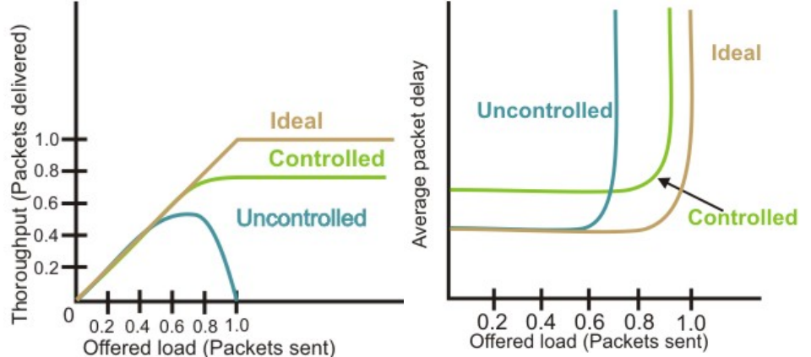
Effects of Congestion
Congestion affects two vital parameters:
Throughput
Delay

Slide 19
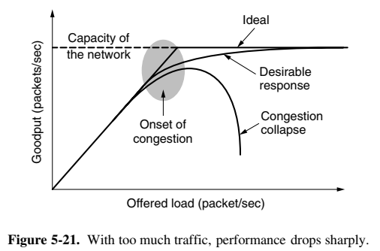
When the number of packets hosts send into the network is well within its carrying capacity, the number delivered is proportional to the number sent.
If twice as many are sent, twice as many are delivered.
However, as the offered load approaches the carrying capacity, bursts of traffic occasionally fill up the buffers inside routers and some packets are lost.
These lost packets consume some of the capacity, so the number of delivered packets falls below the ideal curve.
The network is now congested.

Slide 20
Congestion Control Techniques
Open loop:
Protocols to prevent or avoid congestion, ensuring that the system never enters a Congested State.
Close loop:
Protocols that allow system to enter congested state, detect it, and remove it.

Slide 21
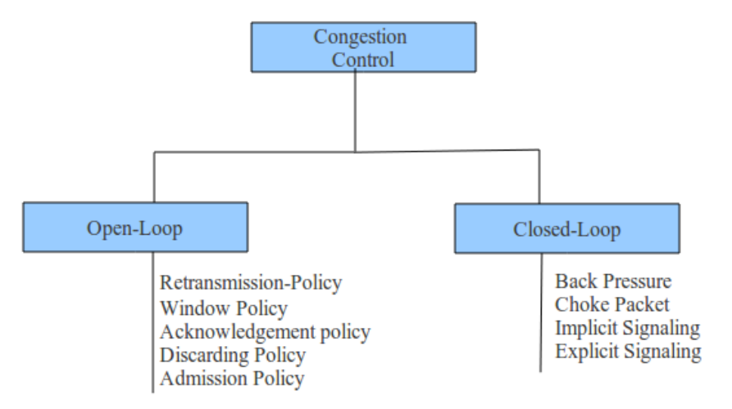

Slide 22
Open Loop: Retransmission Policy
If the sender feels that a sent packet is lost or corrupted, the packet needs to be retransmitted.
Retransmission increase congestion in the network.
However, a good retransmission policy can prevent congestion.
The retransmission policy and the retransmission timers must be designed to optimize efficiency and at the same time prevent congestion.
For example, the retransmission policy used by TCP is designed to prevent or alleviate congestion.

Slide 23
Open Loop: Window Policy
The type of window at the sender may also affect congestion.
The Selective Repeat window is better than the Go-Back-N window for congestion control.
In the Go-Back-N window, when the timer for a packet times out, several packets may be resent, although some may have arrived safe and sound at the receiver.
This duplication may make the congestion worse.
The Selective Repeat window, on the other hand, tries to send the specific packets that have been lost or corrupted.

Slide 24
Open Loop: Acknowledgment Policy
The acknowledgment policy imposed by the receiver may also affect congestion.
If the receiver does not acknowledge every packet it receives, it may slow down the sender and help prevent congestion.
A receiver may send an acknowledgment only if it has a packet to be sent or a special timer expires.
A receiver may decide to acknowledge only N packets at a time.
We need to know that the acknowledgments are also part of the load in a network.
Sending fewer acknowledgments means imposing less load on the network.

Slide 25
Open Loop: Discarding Policy
A good discarding policy by the routers may prevent congestion and at the same time may not harm the integrity of the transmission.
For example, in audio transmission, if the policy is to discard less sensitive packets when congestion is likely to happen, the quality of sound is still preserved and congestion is prevented or alleviated.

Slide 26
Open Loop: Admission Policy
An admission policy, which is a QoS mechanism, can also prevent congestion in virtual-circuit networks.
Switches in a flow first check the resource requirement of a flow before admitting it to the network.
A router can deny establishing a virtual- circuit connection if there is congestion in the network or if there is a possibility of future congestion

Slide 27
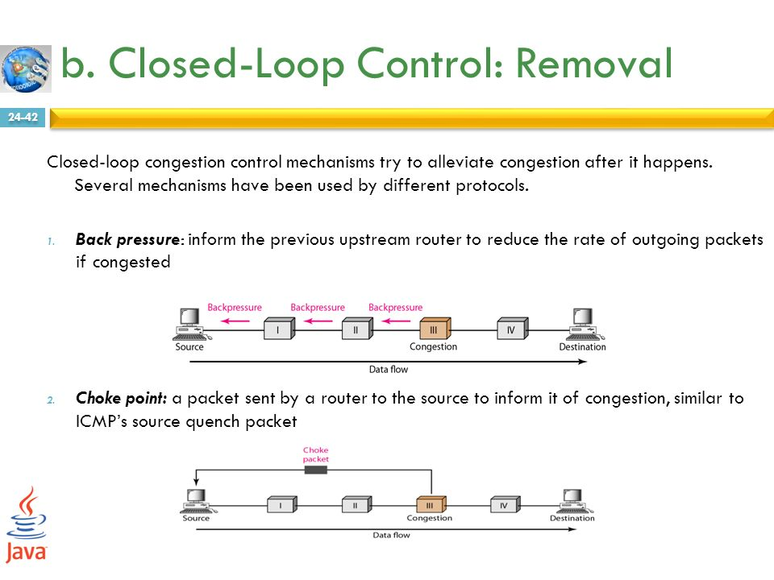
Closed-Loop: Back-pressure
Backpressure is a mechanism in which a congested node stops receiving data from the immediate upstream node or nodes.
This may cause the upstream node or nodes to become congested, and they, in turn, reject data from their upstream nodes or nodes. And so on.
Backpressure is a node-to-node congestion control that starts with a node and propagates, in the opposite direction of data flow, to the source.
The backpressure technique can be applied only to virtual circuit networks, in which each node knows the upstream node from which a flow of data is corning.

Slide 28
Closed-Loop: Choke Packet
A choke packet is a packet sent by a node to the source to inform it of congestion.
In backpressure, the warning is from one node to its upstream node, although the warning may eventually reach the source station.
In the choke packet method, the warning is from the router, which has encountered congestion, to the source station directly.
The intermediate nodes through which the packet has travelled are not warned.
We have seen an example of this type of control in ICMP.
When a router in the Internet is overwhelmed datagrams, it may discard some of them; but it informs the source host, using a source quench ICMP message.
The warning message goes directly to the source station; the intermediate routers does not take any action.

Slide 29
Closed-Loop: Implicit Signaling
In implicit signaling, there is no communication between the congested node or nodes and the source.
The source guesses that there is a congestion somewhere in the network from other symptoms.
For example, when a source sends several packets and there is no acknowledgment for a while, one assumption is that the network is congested.
The delay in receiving an acknowledgment is interpreted as congestion in the network; the source should slow down.

Slide 30
Closed-Loop: Explicit Signaling
The node that experiences congestion can explicitly send a signal to the source or destination.
In the choke packet method, a separate packet is used for this purpose
In the explicit signaling method, the signal is included in the packets that carry data.
Explicit signaling, can occur in either the forward or the backward direction.

Slide 31
Closed-Loop: Explicit Signaling
Backward Signaling:
A bit can be set in a packet moving in the direction opposite to the congestion.
This bit can warn the source that there is congestion and that it needs to slow down to avoid the discarding of packets.
Forward Signaling:
A bit can be set in a packet moving in the direction of the congestion.
This bit can warn the destination that there is congestion.
The receiver in this case can use policies, such as slowing down the acknowledgments, to alleviate the congestion.

Slide 32
Leaky Bucket Algorithm
When the host has to send a packet, the packet is thrown into the bucket.
The bucket leaks at a constant rate, meaning the network interface transmits packets at a constant rate.
Bursty traffic is converted to a uniform traffic by the leaky bucket.
In practice the bucket is a finite queue that outputs at a finite rate

Slide 33
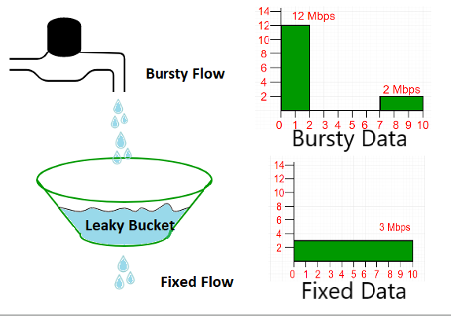
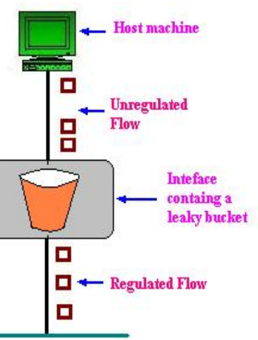
Leaky Bucket Algorithm

Slide 34
Token Bucket Algorithm
In regular intervals tokens are thrown into the bucket.
The bucket has a maximum capacity.
If there is a ready packet, a token is removed from the bucket, and the packet is send.
If there is no token in the bucket, the packet cannot be send.

Slide 35
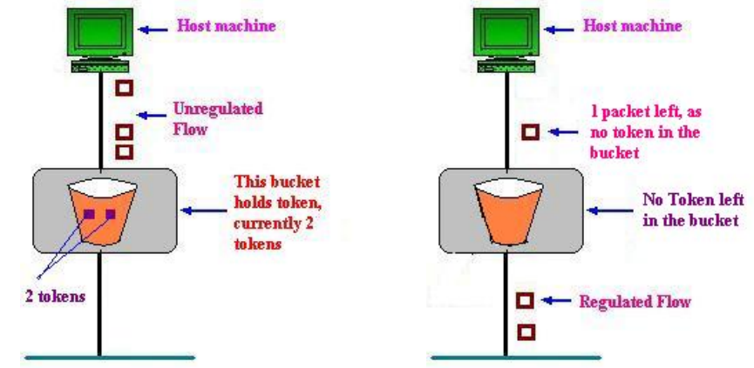
Token Bucket Algorithm

Slide 36
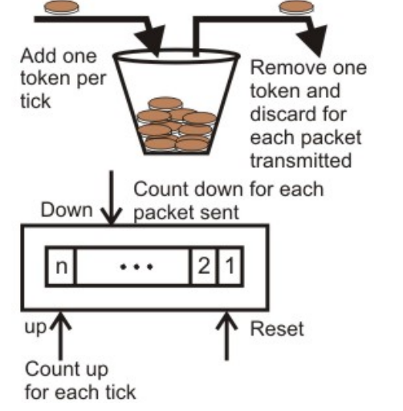
Token Bucket Algorithm

Slide 37
Advantage of Token Bucket over Leaky Bucket
If bucket is full in token Bucket , tokens are discard not packets. While in leaky bucket, packets are discarded.
Token Bucket can send Larger bursts at a faster rate while leaky bucket always sends packets at constant rate.

